Slide 1


Macroeconomics
Ninth Edition
Chapter 15
Monetary Policy
Copyright © 2025, 2021, 2018 Pearson Education, Inc. All Rights Reserved
Notes:
If this PowerPoint presentation contains mathematical equations, you may need to check that your computer has the following installed:
1) MathType Plugin
2) Math Player (free versions available)
3) NVDA Reader (free versions available)

Slide 2
Chapter Outline
15.1 What Is Monetary Policy?
15.2 The Federal Funds Rate and How the Fed Conducts Monetary Policy
15.3 Monetary Policy and Economic Activity
15.4 Monetary Policy in the Dynamic Aggregate Demand and Aggregate Supply Model
15.5 A Closer Look at the Fed’s Setting of Monetary Policy Targets
15.6 Fed Policies during the 2007–2009 and 2020 Recessions
Online Appendix The Money Market and the Fed

Slide 3
The Fed Deals with Two “Once in a Lifetime” Crises in 15 Years
The financial crisis of 2007–2009 was the first to hit the United States since the bank panics of the early 1930s.
The Covid-19 pandemic was the first disease outbreak to push the U.S. economy into a recession since the 1918 influenza pandemic.
Many experts believe the Fed’s rapid responses to both events saved the financial system from collapse and limited the severity of the recessions.
However, the Fed actions were not without criticism.

Slide 4
15.1 What Is Monetary Policy?
Define monetary policy and describe the Federal Reserve’s monetary policy goals.
In Chapter 24, we introduced the monetary policy tools that the Federal Reserve can use to influence the money supply. In this chapter,
We’ll address how and why the Fed takes the actions that it does.
We’ll pay special attention to the unique circumstances surrounding the recessions of 2007–2009 and 2020 and the Fed’s responses to those circumstances.

Slide 5
What Is the Role of the Federal Reserve?
When the Federal Reserve was created in 19 13, its main responsibility was to prevent bank panics.
After the Great Depression of the 19 30s, Congress gave the Fed these broader responsibilities: To act “so as to promote effectively the goals of maximum employment, stable prices, and moderate long-term interest rates.”
Since World War
the Fed has carried out active monetary
policy.
Monetary policy: The actions the Federal Reserve takes to manage the money supply and interest rates to pursue macroeconomic policy objectives.

Slide 6
The Goals of Monetary Policy
The Fed pursues four main monetary policy goals:
Price stability
High employment
Stability of financial markets and institutions
Economic growth
We will consider each goal in turn.

Slide 7
Fed Goal #1: Price Stability
Rising prices reduce the purchasing power of money.
During the 1970s high inflation became problematic in the United States, reaching over 10 percent per year; Fed Chair Paul Volcker used monetary policy to get inflation under control.
High rates of inflation returned in 2021, catching many Fed policymakers by surprise. Debate continues about how much this inflation was due to Covid, and now much was due to monetary and fiscal policy actions.

Slide 8
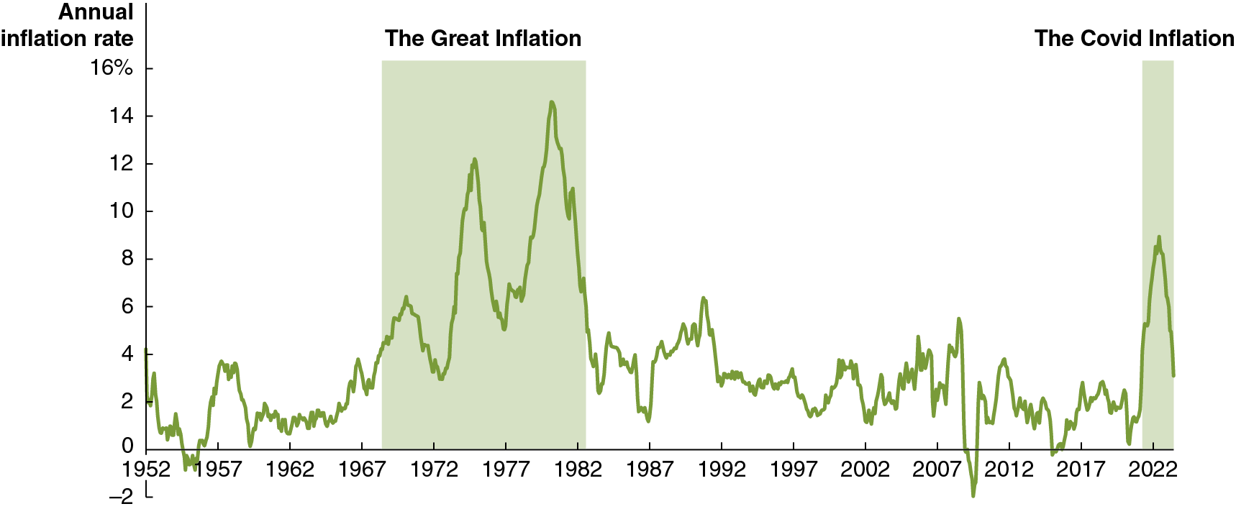
Figure 15.1 The Inflation Rate, January 1952–June 2023
The figure shows C P I inflation in the United States.
Since rising prices erode the value of money as a medium of exchange and a store of value, policymakers in most countries pursue price stability as a primary goal.
Notes:
The horizontal axis represents year, and ranges from 1952 to 2022, in increments of 5 years. The vertical axis represents annual inflation rate, and ranges from negative 2 to 16%, in increments of 2%. The area for The Great Inflation period is shaded between 1968 and 1983, and the area for The Covid Inflation is shaded between 2021 to 2022. A line marks the irregular growth rate over time, maintaining low gains and losses prior to the Great Inflation period, between (1952, 3) and (1968, 4), before experiencing a large rate of growth during the inflation period. The line rises and falls from (1968, 4) to (1981, 14), and falls again after the end of the period, maintaining more compact gains and losses below 4% and above negative 2%. The line rises to (2022, 9) during the Covid inflation period and ends at (2023, 4). All values are estimated.

Slide 9
Fed Goal #2: High Employment
At the end of World War
Congress passed the Employment
Act of 19 46, which stated that it was the:
“responsibility of the Federal Government… to foster and promote… conditions under which there will be afforded useful employment, for those able, willing, and seeking to work, and to promote maximum employment, production, and purchasing power.”
Price stability and high employment are often referred to as the dual mandate of the Fed.

Slide 10
Fed Goal #3: Stability of Financial Markets and Institutions
Stable and efficient financial markets are essential to a growing economy.
The Fed makes funds available to banks in times of crisis, ensuring confidence in those banks.
In 2008, the Fed temporarily made these discount loans available to investment banks also, to ease their liquidity problems.
In 2020, the Fed did the same during the Covid-19 pandemic, in addition to some new lending facilities.

Slide 11
Fed Goal #4: Economic Growth
Economic growth, particularly stable economic growth, encourages long-run investment, which is itself necessary for growth.
It is not clear to what extent the Fed can really encourage long-run investment, beyond meeting the previous three goals; Congress and the president may be in a better position to address this goal.

Slide 12
15.2 The Federal Funds Rate and How the Fed Conducts Monetary Policy
Describe how the Fed uses changes in interest rates to conduct monetary policy.
The Fed would like to see aggregate demand increase at a rate that keeps real G D P close to potential G D P.
The main way the Fed can influence aggregate demand is through interest rates.
The interest rates that have the most effect on aggregate demand are the real interest rates on mortgage loans, corporate bonds, and U.S. Treasury bonds—all long-term interest rates.
One problem the Fed faces is that it can mostly affect short-term interest rates rather than long-term interest rates.

Slide 13
The Importance of the Federal Funds Rate
While banks are no longer required to hold substantial reserves, they still do so because:
The interest they earn on reserves is risk-free.
Large banks must maintain enough high-quality liquid assets to comply with regulations.
When banks need additional reserves, they borrow in the federal funds market, paying the federal funds rate on these very short-term loans—often just overnight.
Federal funds rate: The interest rate banks charge each other for overnight loans.

Slide 14
How the Fed Uses the Federal Funds Rate
The Federal Open Market Committee (F O M C) does not control the federal funds rate directly, but instead sets targets for it; in October 2023 the target was 5.25 to 5.50 percent.
The Fed uses different monetary policy tools in different circumstances to influence the federal funds rate.
Type of monetary policy | Purpose | Method
Expansionary | Increase the growth of aggregate demand, real G D P, and employment | Lower the target for the federal funds rate
Contractionary | Decrease the growth of aggregate demand, real G D P, and employment | Raise the target for the federal funds rate

Slide 15
Controlling the Federal Funds Rate
The Fed uses different tools to control the federal funds rate depending on the level of reserves banks choose to keep:
Situation | Name | Method for controlling the federal funds rate
Banks keep as few reserves as regulations allow | Scarce-reserves regime | Adjust the supply of reserves
Banks keep more reserves than required | Ample-reserves regime | Adjust the interest rate on reserve balances (I O R B)

Slide 16
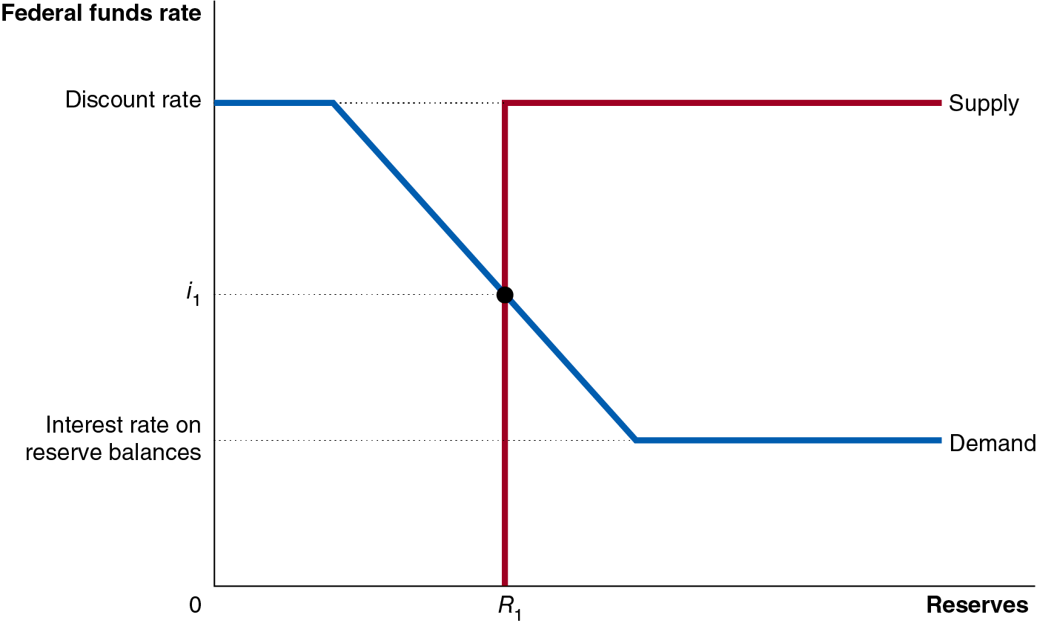
Figure 15.2 Equilibrium in the Federal Funds Market in a Scarce-Reserves Regime (1 of 3)
The demand for reserves is downward sloping because as the federal funds rate increases, the opportunity cost to banks of holding excess reserves increases.
The discount rate is a ceiling on the demand for reserves, and the interest rate on reserve balances (I O R B) is a floor.
Notes:
The horizontal axis represents, federal funds rate and the vertical axis represents reserves. The supply line rises vertically from reserve, r sub 1 on the horizontal axis through federal funds rate, i sub 1 to discount rate and then runs horizontally along the discount rate. The demand line runs horizontally from the discount rate for a short distance, and then falls through federal funds rate, i sub 1 to the interest rates on reserve balances, and then runs horizontally for a short distance.

Slide 17
Figure 15.2 Equilibrium in the Federal Funds Market in a Scarce-Reserves Regime (2 of 3)
The supply of reserves is a vertical line because we assume the Fed can supply the quantity of reserves it needs to achieve its target federal funds rate.
Supply becomes horizontal because we assume that the Fed will supply banks with whatever reserves they want at the discount rate.
Notes:
The horizontal axis represents, federal funds rate and the vertical axis represents reserves. The supply line rises vertically from reserve, r sub 1 on the horizontal axis through federal funds rate, i sub 1 to discount rate and then runs horizontally along the discount rate. The demand line runs horizontally from the discount rate for a short distance, and then falls through federal funds rate, i sub 1 to the interest rates on reserve balances, and then runs horizontally for a short distance.

Slide 18
Figure 15.2 Equilibrium in the Federal Funds Market in a Scarce-Reserves Regime (3 of 3)
Equilibrium occurs where the quantity of reserves demanded by banks equals the quantity of reserves supplied by the Fed.
By controlling the quantity of reserves supplied, the Fed can change the federal funds rate.
Notes:
The horizontal axis represents, federal funds rate and the vertical axis represents reserves. The supply line rises vertically from reserve, r sub 1 on the horizontal axis through federal funds rate, i sub 1 to discount rate and then runs horizontally along the discount rate. The demand line runs horizontally from the discount rate for a short distance, and then falls through federal funds rate, i sub 1 to the interest rates on reserve balances, and then runs horizontally for a short distance.

Slide 19
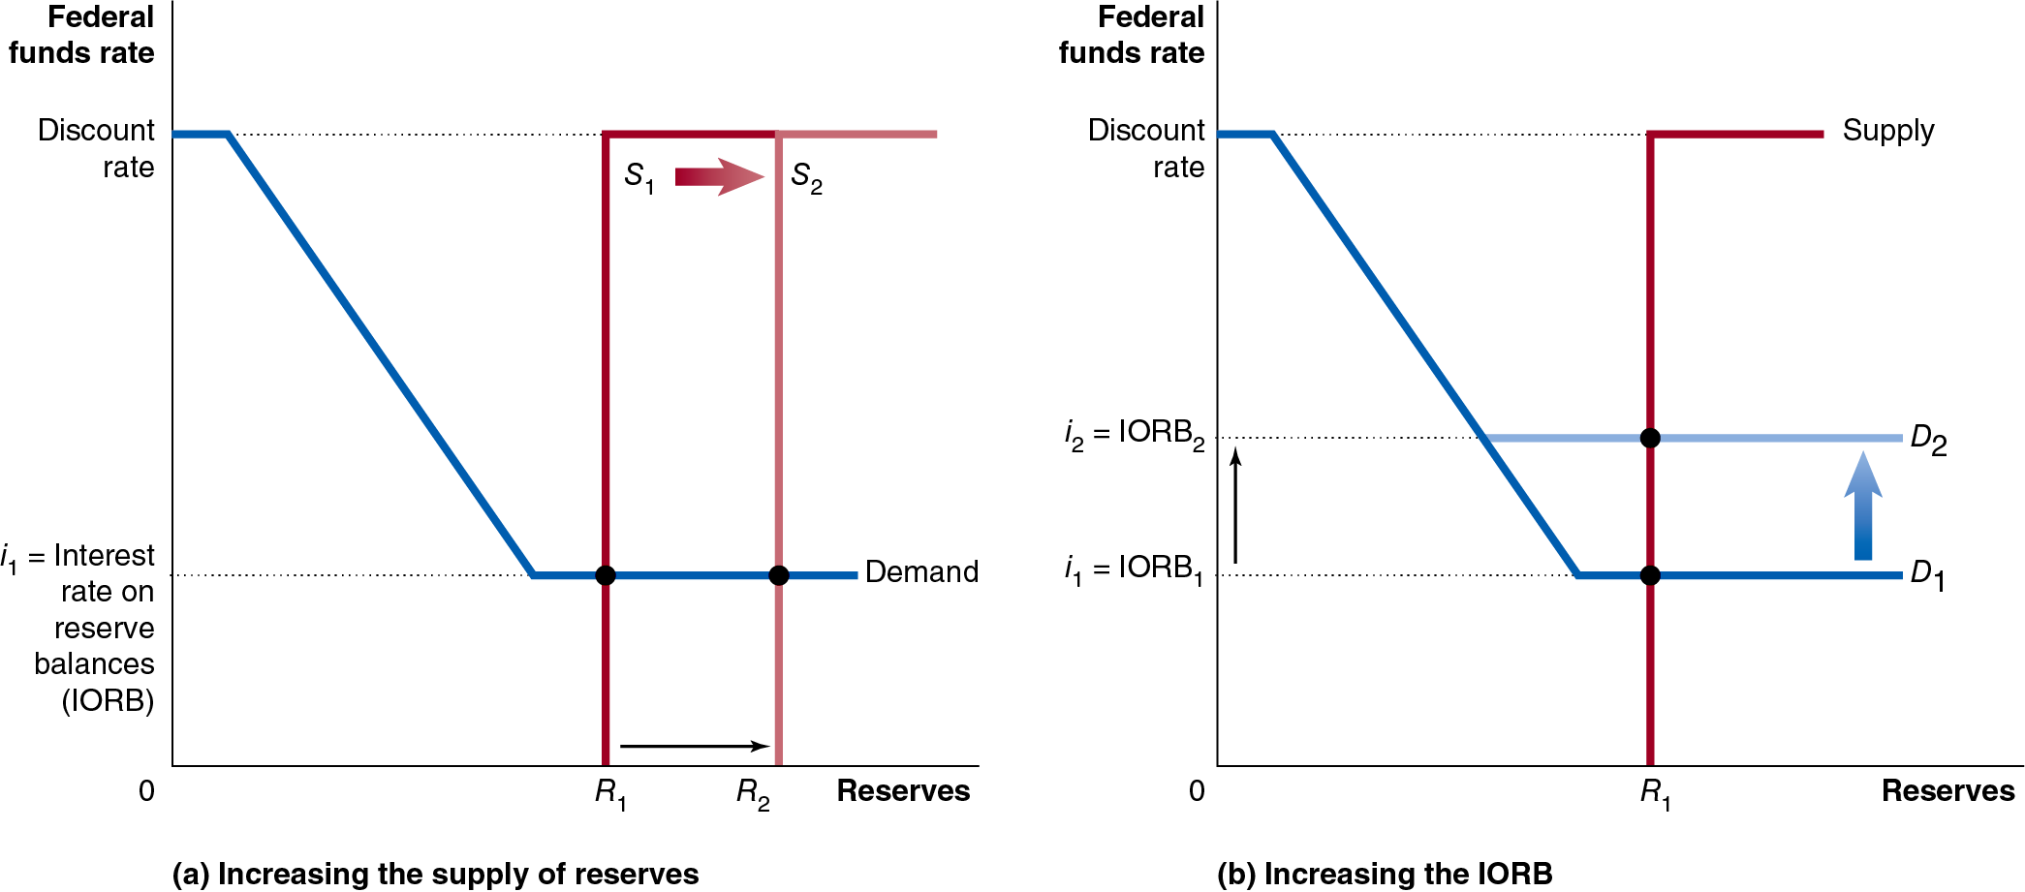
Figure 15.3 The Fed Increases the Federal Funds Rate in an Ample-Reserves Regime (1 of 2)
When banks hold more reserves than they need, changing the supply of reserves does not change the equilibrium federal funds rate—panel (a).
In this situation, the federal funds rate equals the interest on reserve balances (I O R B).
Notes:
In both graphs, the horizontal axis represents, federal funds rate and the vertical axis represents reserves.
(a) The graph represents increasing the supply of reserves, the supply line, s sub 1, rises vertically from reserve, r sub 1 on the horizontal axis to discount rate and then runs horizontally along the discount rate. The supply line, s sub 1, shifts right to become s sub 2. The demand line runs horizontally from the discount rate for a short distance, and then falls to i sub 1 = interest rate on reserve balances, I O R B, and then runs horizontally for a short distance.
(b) The graph represents increasing the I O R B, the supply line, s sub 1, rises vertically from reserve, r sub 1 on the horizontal axis to discount rate and then runs horizontally along the discount rate. The demand line, D sub 1, runs horizontally from the discount rate for a short distance, and then falls to i sub 1 = I O R B sub 1, and then runs horizontally for a short distance. The demand line, D sub 1, shifts upward to become D sub 2. The demand line, D sub 2, runs horizontally from the discount rate for a short distance, and then falls to i sub 2 = I O R B sub 2, and then runs horizontally for a short distance.

Slide 20
Figure 15.3 The Fed Increases the Federal Funds Rate in an Ample-Reserves Regime (2 of 2)
Instead, the Fed can affect the equilibrium federal funds rate by controlling the I O R B.
Raising the I O R B will raise the federal funds rate—panel (b).
Notes:
In both graphs, the horizontal axis represents, federal funds rate and the vertical axis represents reserves.
(a) The graph represents increasing the supply of reserves, the supply line, s sub 1, rises vertically from reserve, r sub 1 on the horizontal axis to discount rate and then runs horizontally along the discount rate. The supply line, s sub 1, shifts right to become s sub 2. The demand line runs horizontally from the discount rate for a short distance, and then falls to i sub 1 = interest rate on reserve balances, I O R B, and then runs horizontally for a short distance.
(b) The graph represents increasing the I O R B, the supply line, s sub 1, rises vertically from reserve, r sub 1 on the horizontal axis to discount rate and then runs horizontally along the discount rate. The demand line, D sub 1, runs horizontally from the discount rate for a short distance, and then falls to i sub 1 = I O R B sub 1, and then runs horizontally for a short distance. The demand line, D sub 1, shifts upward to become D sub 2. The demand line, D sub 2, runs horizontally from the discount rate for a short distance, and then falls to i sub 2 = I O R B sub 2, and then runs horizontally for a short distance.

Slide 21
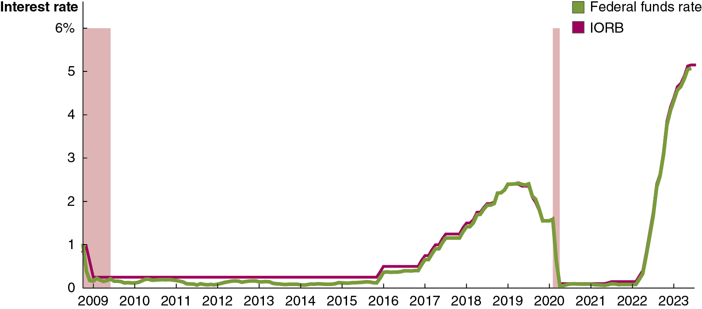
Figure 15.4 The I O R B and the Federal Funds Rate
Even in an ample-reserves regime, the federal funds rate and I O R B don’t exactly match; the federal funds rate can be lower than the I O R B.
Why? Some government-sponsored enterprises like Fannie Mae can borrow and lend in the federal funds market, but they earn no interest on their deposits with the Fed; so they are willing to lend funds at below the I O R B.
Notes:
The horizontal axis represents year, and ranges from 2009 to 2023, in increments of 1. The vertical axis represents interest rate, and ranges from 0 to 6%, in increments of 1%. The area for recession periods, 2007 to 2009, and 2020 are shaded. The line for Federal funds rate starts at 1 in 2009, moves along the horizontal axis within 0.4 till 2016, rises to 2.6 in 2019, falls to 0 in 2020, and moves along the horizontal axis until 2022, peaks to 5.5 in 2023. The line for I O R B starts at 1 in 2009, moves along the horizontal axis at 0.4 till 2016, rises to 2.6 in 2019, falls to 0 in 2020, and moves along the horizontal axis until 2022, peaks to 5.5 in 2023. All values are estimated.

Slide 22
The Interest Rate on Overnight Reverse Repurchase Agreements (O N R R P)
In order to put a true floor under the value of the federal funds rate, the Fed uses the interest rate it pays on overnight reverse repurchase agreements (O N R R P): financial transactions in which the Fed borrows funds overnight from a financial firm.
Under a reverse repurchase agreement, the Fed sells a security to a financial firm with the promise to buy it back the next day. This results in the firm investing funds overnight with the Fed.
G S E s like Fannie Mae are allowed to use these O N R R P s, and they are risk-free, so this creates a true lower bound for the federal funds rate.

Slide 23
Effectiveness of Administered Rates
The interest rate on reserve balances (I O R B) and the interest rate on overnight reverse repurchase agreements (O N R R P) are set by the Fed, rather than resulting from a market equilibrium; we call those administered rates.
Using these rates, the Fed can tightly control the federal funds rate: in October 2023, the I O R B was 5.40 percent, the federal funds rate was 5.33 percent, and the interest rate on O N R R P s was 5.40 percent.
Because the Fed is putting a floor under the federal funds rate, we say it is using a floor operating system: The current system under which the Fed uses the interest rate on banks’ reserve balances and the interest rate on overnight loans with financial firms to establish a floor under the federal funds rate.

Slide 24
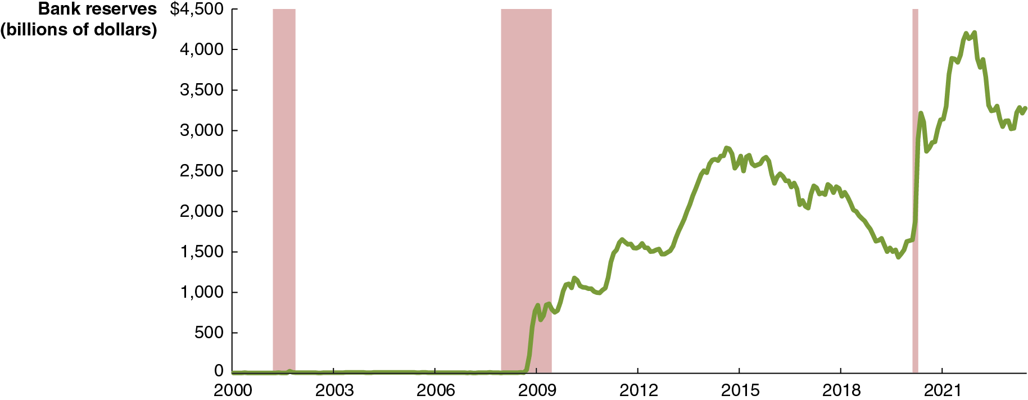
Figure 15.5 Quantitative Easing Led to Large Increases in Bank Reserves (1 of 3)
When the economy is in a recession, the Fed would like to lower the federal funds rate to increase aggregate demand.
But the rate cannot go below zero: financial firms won’t pay to lend money to the Fed. This is the zero lower bound.
To conduct more expansionary monetary policy, the Fed performs quantitative easing and forward guidance.
Notes:
The horizontal axis represents year, and ranges from 2000 to 2021, in increments of 1. The vertical axis represents bank reserves, in billions of dollars, and ranges from 0 to $4,500, in increments of 500. The area for recession periods, 2001 to 2002, 2007 to 2009, and 2020 are shaded. The line starts at 0 in 2000, moves along the horizontal axis till 2009, rises to 2,600 in 2015, falls to 1,400 in 2020, peaks to 4,300 in 2022, and ends at 3,000 in 2023. All values are estimated.

Slide 25
Figure 15.5 Quantitative Easing Led to Large Increases in Bank Reserves (2 of 3)
Quantitative easing: The Fed policy that attempts to increase aggregate demand by buying long-term securities, such as 10-year Treasury notes.
The Fed relied on quantitative easing when facing the zero lower bound for the federal funds rate, both during the Great Recession and during the Covid-19 pandemic.
Buying these long-term Treasury securities and mortgage-backed securities increased their prices and hence reduced their interest rates or yields.
Notes:
The horizontal axis represents year, and ranges from 2000 to 2021, in increments of 1. The vertical axis represents bank reserves, in billions of dollars, and ranges from 0 to $4,500, in increments of 500. The area for recession periods, 2001 to 2002, 2007 to 2009, and 2020 are shaded. The line starts at 0 in 2000, moves along the horizontal axis till 2009, rises to 2,600 in 2015, falls to 1,400 in 2020, peaks to 4,300 in 2022, and ends at 3,000 in 2023. All values are estimated.

Slide 26
Figure 15.5 Quantitative Easing Led to Large Increases in Bank Reserves (3 of 3)
To be effective, monetary policy needs to affect long-term interest rates, such as the interest rates on corporate bonds and on mortgages.
Forward guidance refers to statements by the Federal Open Market Committee about how it will conduct monetary policy in the future.
Forward guidance signals to households, firms, and investors that the Fed intends to keep the target for the federal funds rate near zero for a prolonged period, encouraging investors to believe rates will remain low in the future.
Notes:
The horizontal axis represents year, and ranges from 2000 to 2021, in increments of 1. The vertical axis represents bank reserves, in billions of dollars, and ranges from 0 to $4,500, in increments of 500. The area for recession periods, 2001 to 2002, 2007 to 2009, and 2020 are shaded. The line starts at 0 in 2000, moves along the horizontal axis till 2009, rises to 2,600 in 2015, falls to 1,400 in 2020, peaks to 4,300 in 2022, and ends at 3,000 in 2023. All values are estimated.

Slide 27
Summary of the Fed’s Monetary Policy Tools (1 of 2)
The Fed’s two most important tools:
Interest on reserve balances (I O R B)—to manage the federal funds rate
The interest rate on overnight reverse repurchase agreements (O N R R P)—for a lower bound on the federal funds rate
The two tools the fed uses when faces with a zero lower bound:
Quantitative easing—when the Fed faces the zero lower bound on the federal funds rate
Forward guidance—to signal the Fed’s intent to keep the federal funds rate close to zero for a prolonged time

Slide 28
Summary of the Fed’s Monetary Policy Tools (2 of 2)
The Fed’s three traditional tools:
Open market operations—buying and selling Treasury securities to adjust the level of reserves in order to control the federal funds rate; the main tool the Fed used in a scarce-reserves regime
Discount rate—the interest rate the Fed charges for discount loans, made to firms in the Fed’s capacity as the lender of last resort; set higher than the federal funds rate, and sometimes called the penalty rate
Reserve requirements—until March 2020 the Fed specified a minimum percentage of checking deposits banks needed to keep, called the required reserve ratio; in practice, the Fed hadn’t used this tool in decades

Slide 29
15.3 Monetary Policy and Economic Activity
Use aggregate demand and aggregate supply graphs to show the effects of monetary policy on real G D P and the price level.
The ability of the Fed to affect economic variables such as real G D P depends on its ability to affect long-term real interest rates.
It uses the federal funds rate (a short-term nominal interest rate) for this—an imperfect tool.

Slide 30
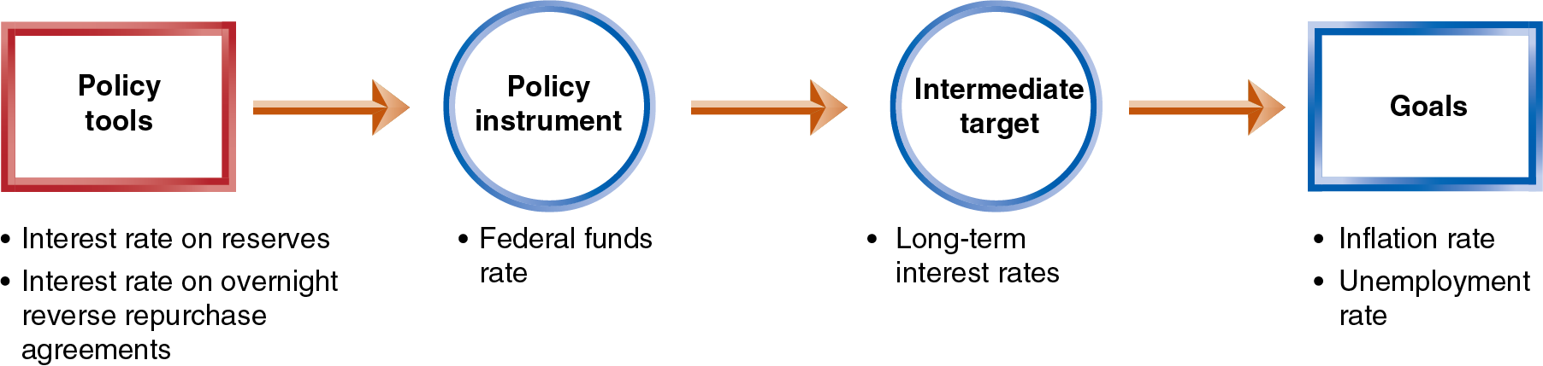
Figure 15.6 How the Fed Attempts to Achieve Its Policy Goals
For monetary policy to be effective, the links in the chain above must be reliable.
The first link is very reliable, but the remaining ones are more uncertain.
We will assume in this section that the Fed can affect long-term real interest rates using its policy tools.
Notes:
The flow diagram is as follows.
Policy tools
Policy instrument
Intermediate target
Goals
Policy tools include as follows.
Interest rate on reserves
Interest rate on overnight reverse repurchase agreements
Policy instrument includes Federal funds rate.
Intermediate target includes long term interest rates.
Goals include as follows.
Inflation rate
Unemployment rate

Slide 31
How Interest Rates Affect Aggregate Demand
Consumption
Lower interest rates encourage buying on credit, which typically affects the sale of durables. Lower rates also discourage saving.
Investment
Lower interest rates encourage capital investment by firms:
By making it cheaper to borrow (sell corporate bonds).
By making stocks more attractive for households to purchase, allowing firms to raise funds by selling additional stock.
Lower rates also encourage new residential investment.
Net exports
High U.S. interest rates attract foreign funds, raising the $U S exchange rate, causing net exports to fall.

Slide 32
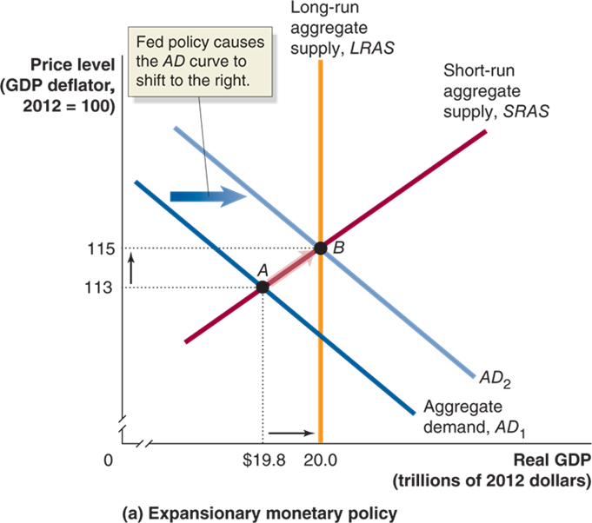
Figure 15.7 Monetary Policy (1 of 2)
The Fed conducts expansionary monetary policy when it takes actions to decrease interest rates to increase real G D P.
This works because decreases in interest rates raise consumption, investment, and net exports.
The Fed would take this action when short-run equilibrium real G D P was below potential real G D P.
The increase in aggregate demand encourages increased employment, one of the Fed’s primary goals.
Notes:
Truncated graphs A, the X axis represents real G D P, in trillions of 2012 dollars, and the Y axis represents price level with a G D P deflator, when 2012 = 100. Graph A represents expansionary monetary policy. Aggregate demand line A D sub 1, shifts right and becomes A D sub 2. Fed policy causes the A D curve to shift to the right. The Short run aggregate supply line, S R A S intersects A D sub 1 at point A, (19.8, 113), and intersects Long run aggregate supply line, L R A S, and A D sub 2 at point B, (20.0, 115).

Slide 33
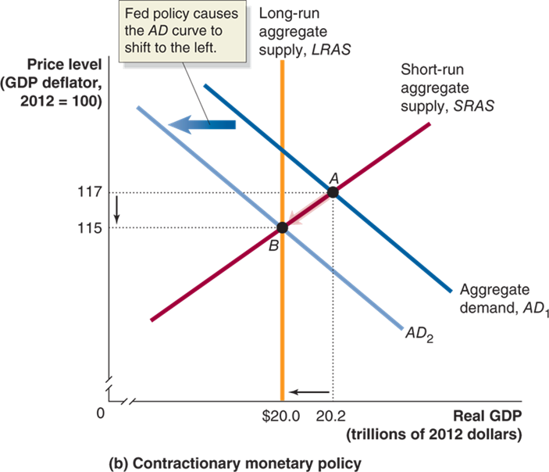
Figure 15.7 Monetary Policy (2 of 2)
Sometimes the economy may be producing above potential G D P.
In that case, the Fed may perform contractionary monetary policy: increasing interest rates to reduce inflation.
Why would the Fed intentionally reduce real G D P?
The Fed is mostly concerned with long-run growth. If it determines that inflation is a danger to long-run growth, it can contract the money supply to discourage inflation, that is, encouraging price stability.
Notes:
In truncated graph B, the X axis represents real GDP, in trillions of 2012 dollars, and the Y axis represents price level with a GDP deflator, when 2012 = 100. Graph B represents contractionary monetary policy. Aggregate demand line AD sub 1, shifts left and becomes AD sub 2. Fed policy causes the AD curve to shift to the left. The short-run aggregate supply line, SRAS intersects AD sub 1 at point A, (20.2, 117), and intersects long-run aggregate supply line, LRAS, and AD sub 2 at point B, (20.0, 115).

Slide 34
Can the Fed Eliminate Recessions?
In our demonstration of monetary policy, the Fed
knew how far to shift aggregate demand, and
was able to shift aggregate demand exactly this far.
In practice, monetary policy is much harder to get right than the graphs make it appear.
Completely offsetting a recession is not realistic; the best the Fed can hope for is to make recessions milder and shorter.
Another complicating factor is that current economic variables are not known; we usually can only know them for the past—that is, with a lag.
In November 2001, N B E R announced that the economy was in a recession that had begun in March 2001; several months later, it announced the recession ended… in November 2001.

Slide 35
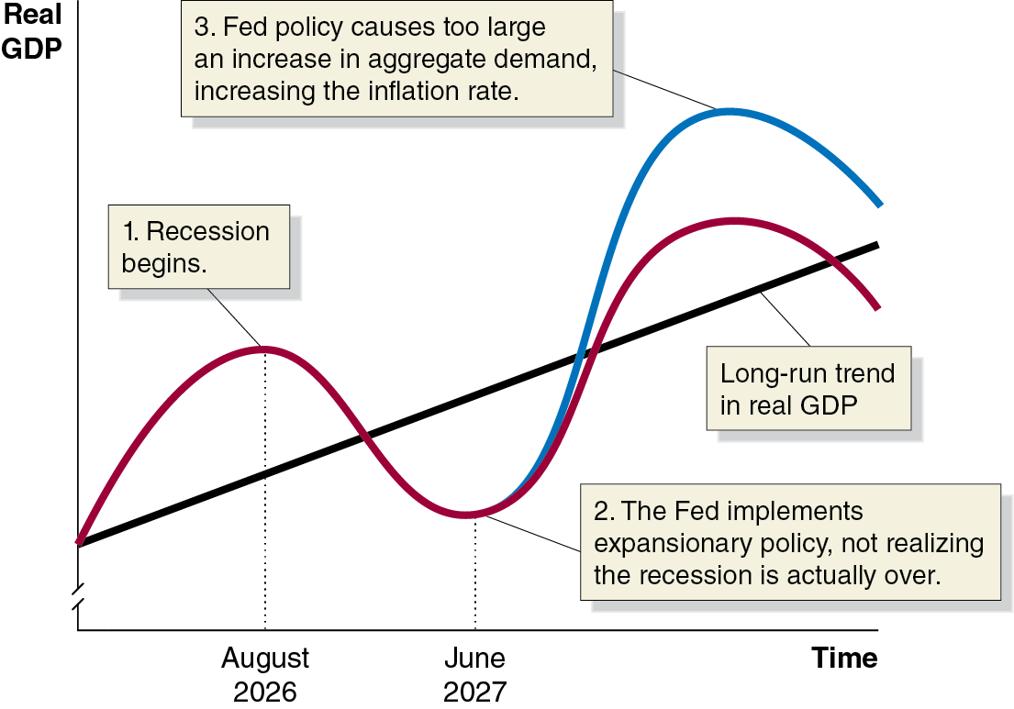
Figure 15.8 The Effect of a Poorly Timed Monetary Policy on the Economy
Suppose a recession begins in August 2026.
The Fed finds out about the recession with a lag.
In June 2027, the Fed starts expansionary monetary policy, but the recession has already ended.
By keeping interest rates low for too long, the Fed encourages real G D P to go far beyond potential G D P. The result:
High inflation
The next recession will be more severe.
Notes:
The horizontal axis represents time, and the truncated vertical axis represents real G D P. The long run trend in real G D P line rises diagonally across the graph. A curve in red representing recession periods begins at the same point, and rises in August 2026, signifying the beginning of a recession. The curve dips below the long run trend line in June 2027, where the Fed implements expansionary policy, not realizing the recession is actually over, before the line begins to gain, rises over, and falls through the long run trend line. A curve in blue rises from the lowest point of the recession trend in June 2027, rising over the long run trend line and rising recession curve. Fed policy causes too large an increase in aggregate demand, increasing the inflation rate.

Slide 36
Table 15.1 Fed Forecasts of Real G D P Growth During 2007 and 2008
Date Forecast Was Made | Forecast Growth Rate For 2007 | Forecast Growth Rate For 2008 | Actual Growth Rate 2007 | Actual Growth Rate 2008
February 2006 | 3% to 4% | No forecast | 2.0% | 0.1%
May 2006 | 2.5% to 3.25% | No forecast | 2.0% | 0.1%
February 2007 | 2.25% to 3.25% | 2.5% to 3.25% | 2.0% | 0.1%
July 2007 | No forecast | 2.5% to 3.0% | 2.0% | 0.1%
The Fed tries to set policy according to what it forecasts the state of the economy will be in the future.
Good policy requires accurate forecasts.
The forecasts of most economists in
did not anticipate the
severity of the coming recession.
So the Fed missed the opportunity to dampen the effects of the recession

Slide 37
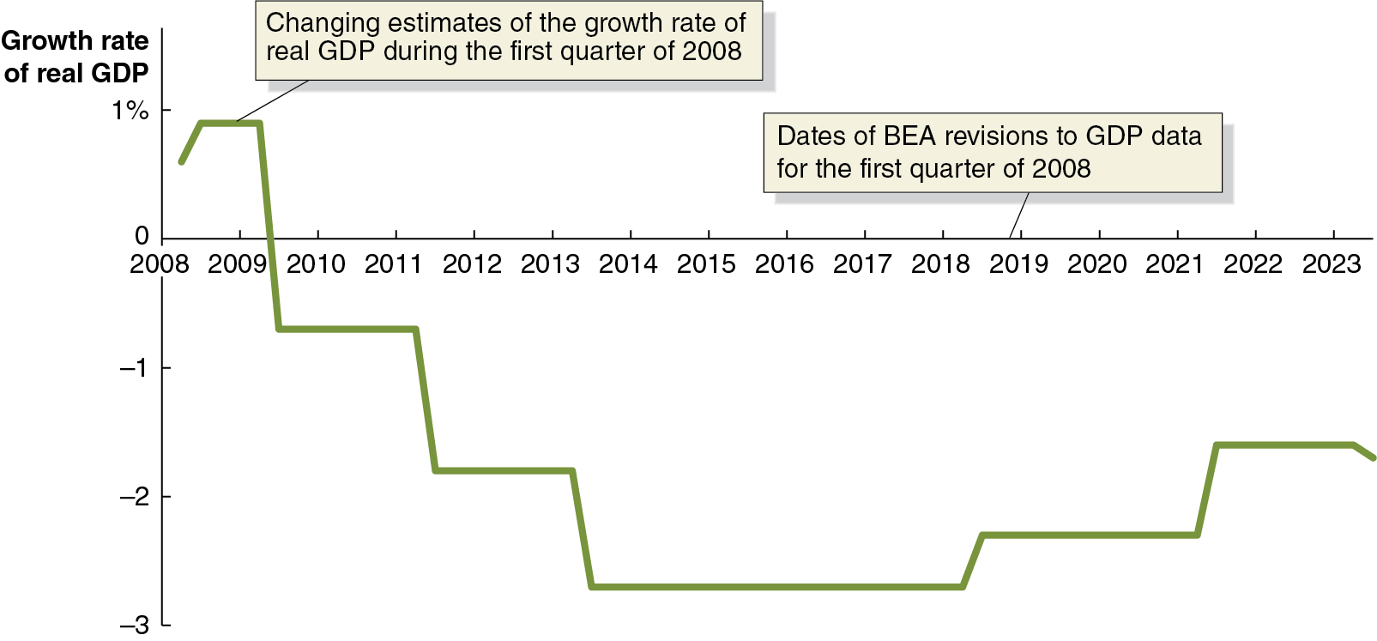
Apply the Concept: Trying to Hit a Moving Target
As if the Fed’s job wasn’t hard enough, it also has to deal with changing estimates of important economic variables.
G D P from the first quarter of 2008 was initially estimated to have increased by 0.6 percent. But the estimate changed over time.
Not only was it revised later in 2008, it was revised in 2009, 2011, 2013, and even again in 2018 and 2021!
Notes:
The horizontal axis represents year, and ranges from 2008 to 2023, in increments of 1. The vertical axis represents growth rate of real G D P, and ranges from negative 3 to 1%, in increments of 1%. The year, 2019 is labeled, dates of B E A revisions to G D P data for the first quarter of 2008. The line rises from 0.6 in 2008 to 1 in 2009, falls to negative 0.6 in 2011, gradually falls to negative 2.6 in 2013 in steps, remains at negative 2.6 between 2013 and 2018, rises to negative 1.6 in steps and remains at negative 1.6 from 2021 to 2023, and ends at negative 1.8. The line at 1 in 2009 is labeled, changing estimates of the growth rate of real G D P during the first quarter of 2008. All values are estimated.

Slide 38
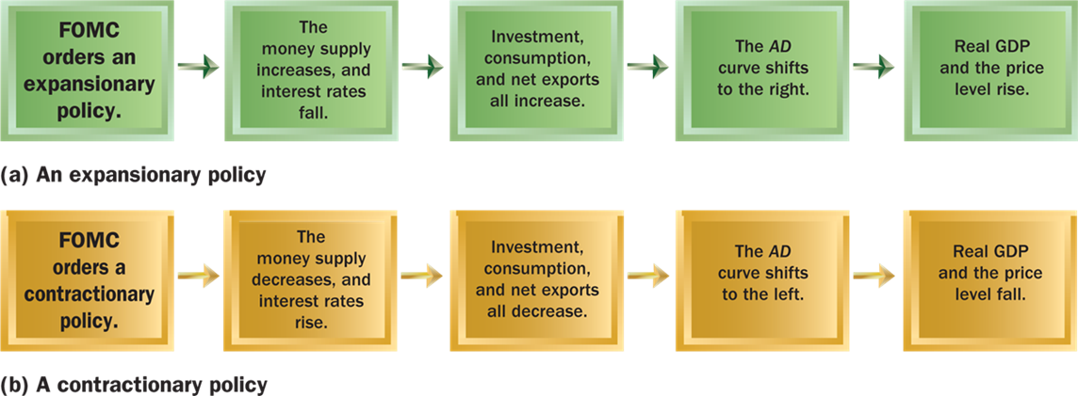
Figure 15.9 Expansionary and Contractionary Monetary Policies
In each of these steps, the changes are relative to what would have happened without the monetary policy.
Expansionary monetary policy is sometimes called “loose” or “easy” monetary policy.
Contractionary monetary policy is “tight” monetary policy.
Notes:
Part (a) represents an expansionary policy in the following steps.
1. FOMC orders an expansionary policy.
2. The money supply increases and interest rates fall.
3. Investment, consumption, and net exports all increase.
4. The AD curve shifts to the right.
5. Real GDP and the price level rise.
Part (b) represents a contractionary policy in the following steps.
1. FOMC orders a contractionary policy.
2. The money supply decreases, and the interest rates rise.
3. Investment, consumption, and net exports all decrease.
4. The AD curve shifts to the left.
5. Real GDP and the price level fall.

Slide 39
15.4 Monetary Policy in the Dynamic Aggregate Demand and Aggregate Supply Model
Use the dynamic aggregate demand and aggregate supply model to analyze monetary policy.
We used the static A D-A S model initially for simplicity.
But in reality, potential G D P increases every year (long-run growth) and the economy generally experiences inflation every year.
We can account for these in the dynamic aggregate demand and aggregate supply model. Recall that this features:
Annual increases in long-run aggregate supply (potential G D P)
Typically, larger annual increases in aggregate demand
Typically, smaller annual increases in short-run aggregate supply
Typically, therefore, annual increases in the price level

Slide 40
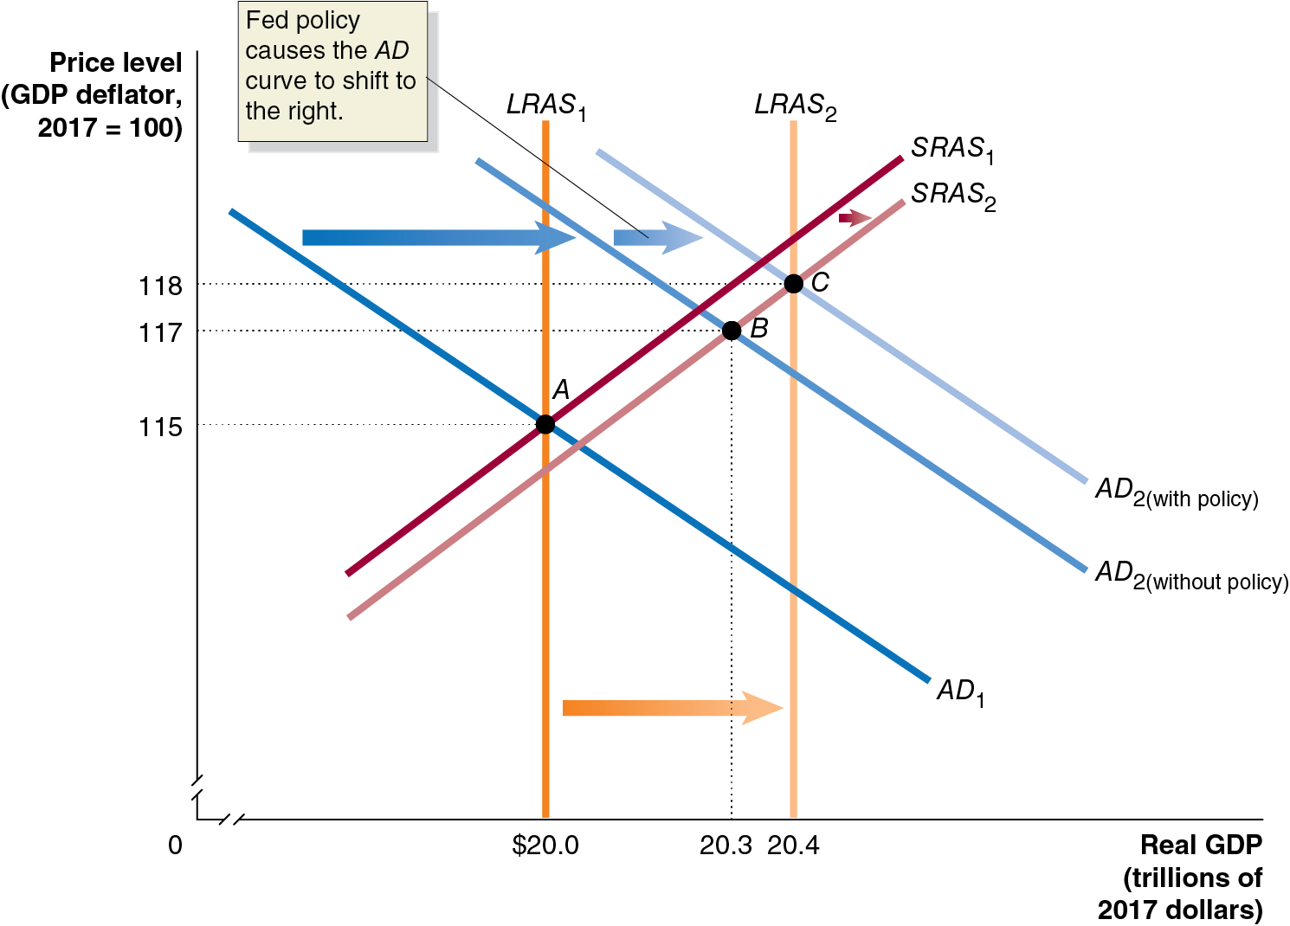
Figure 15.10 An Expansionary Monetary Policy (1 of 2)
In period 1, the economy is in long-run equilibrium at $20.0 trillion.
The Fed forecasts that aggregate demand will not rise fast enough, so that in period 2, the short-run equilibrium will fall below potential G D P, at $20.3 trillion.
Notes:
The horizontal axis represents real G D P, in trillions of 2017 dollars, and ranges from 0 to 20.4, with a kink near the origin. The vertical axis represents price level, G D P deflator, 2017 = 100, and ranges from 0 to 118, with a kink near the origin. A D sub 1 line shifts right and becomes A D sub 2 without policy, shifts right again, and becomes A D sub 2 with policy. Fed policy causes the A D curve to shift to the right. The vertical L R A S sub 1 shifts right and becomes L R A S sub 2. Line S R A S sub 1 shifts right and becomes S R A S sub 2. A D sub 1 intersects S R A S sub 1 and L R A S sub 1 at point A, (20.0, 115). A D sub 2 without policy, and S R A S sub 2 at point B, (20.3, 117). A D sub 2 with policy intersects S R A S sub 2 and L R A S sub 2 at point C, (20.4, 118).

Slide 41
Figure 15.10 An Expansionary Monetary Policy (2 of 2)
So the Fed uses expansionary monetary policy to increase aggregate demand.
The result: real G D P at its potential and a higher level of inflation than would otherwise have occurred.
Notes:
The horizontal axis represents real G D P, in trillions of 2017 dollars, and ranges from 0 to 20.4, with a kink near the origin. The vertical axis represents price level, G D P deflator, 2017 = 100, and ranges from 0 to 118, with a kink near the origin. A D sub 1 line shifts right and becomes A D sub 2 without policy, shifts right again, and becomes A D sub 2 with policy. Fed policy causes the A D curve to shift to the right. The vertical L R A S sub 1 shifts right and becomes L R A S sub 2. Line S R A S sub 1 shifts right and becomes S R A S sub 2. A D sub 1 intersects S R A S sub 1 and L R A S sub 1 at point A, (20.0, 115). A D sub 2 without policy, and S R A S sub 2 at point B, (20.3, 117). A D sub 2 with policy intersects S R A S sub 2 and L R A S sub 2 at point C, (20.4, 118).

Slide 42
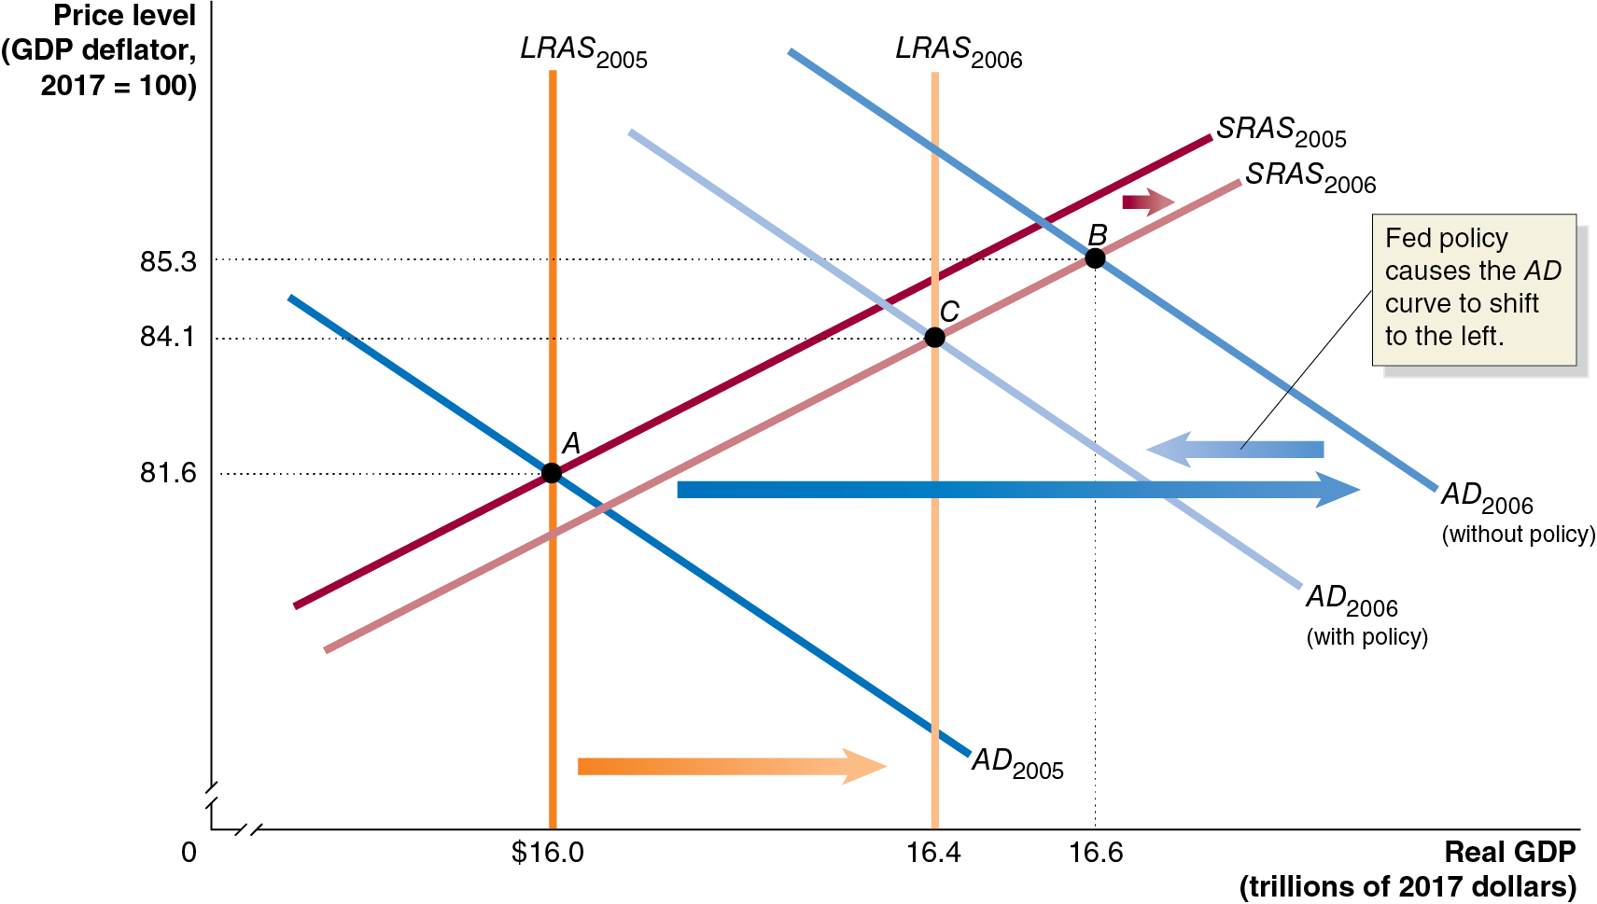
Figure 15.11 A Contractionary Monetary Policy in 2006 (1 of 2)
In 2005, the Fed believed the economy was in long-run equilibrium.
In 2006, the Fed believed aggregate demand growth was going to be “too high,” resulting in excessive inflation.
Notes:
The horizontal axis represents real G D P, in trillions of 2017 dollars, and ranges from 0 to 16.6, with a kink near the origin. The vertical axis represents price level, G D P deflator, 2017 = 100, and ranges from 0 to 85.3, with a kink near the origin. Line A D sub 2005 shifts right and becomes A D sub 2006 without policy. A D sub 2006 without policy shifts left, and becomes A D sub 2006 with policy. Fed policy causes the A D curve to shift to the left. L R A S sub 2005 shifts right and becomes L R A S sub 2006. S R A S sub 2005 shifts right and becomes S R A S sub 2006. A D sub 2005 intersects L R A S sub 2005 and S R A S sub 2005 at point A, (16.0, 81.6). A D sub 2006 without policy intersects S R A S sub 2006 at point B, (16.6, 85.3). A D sub 2006 with policy intersects L R A S sub 2006, and S R A S sub 2006 at point C, (16.4, 84.1).

Slide 43
Figure 15.11 A Contractionary Monetary Policy in 2006 (2 of 2)
So the Fed raised the federal funds rate—a contractionary monetary policy, designed to decrease inflation.
The result: lower real G D P and less inflation in 2006 than would otherwise have occurred.
Notes:
The horizontal axis represents real G D P, in trillions of 2017 dollars, and ranges from 0 to 16.6, with a kink near the origin. The vertical axis represents price level, G D P deflator, 2017 = 100, and ranges from 0 to 85.3, with a kink near the origin. Line A D sub 2005 shifts right and becomes A D sub 2006 without policy. A D sub 2006 without policy shifts left, and becomes A D sub 2006 with policy. Fed policy causes the A D curve to shift to the left. L R A S sub 2005 shifts right and becomes L R A S sub 2006. S R A S sub 2005 shifts right and becomes S R A S sub 2006. A D sub 2005 intersects L R A S sub 2005 and S R A S sub 2005 at point A, (16.0, 81.6). A D sub 2006 without policy intersects S R A S sub 2006 at point B, (16.6, 85.3). A D sub 2006 with policy intersects L R A S sub 2006, and S R A S sub 2006 at point C, (16.4, 84.1).

Slide 44
15.5 A Closer Look at the Fed’s Setting of Monetary Policy Targets
Describe the Fed’s setting of monetary policy targets.
In normal times, the Fed targets the federal funds rate.
One alternative to this is to target the money supply instead.
Should it use the money supply as its monetary policy target instead?

Slide 45
Should the Fed Target the Money Supply?
Monetarists, led by Nobel Laureate Milton Friedman, said “yes.”
Friedman advocated a monetary growth rule, increasing the money supply at about the long-run rate of real G D P growth.
He argued that an active countercyclical monetary policy would serve to destabilize the economy; the monetary growth rule would provide stability instead.
Monetarism was popular in the 1970s, but since the 1980s, the link between the money supply and real G D P seems to have broken down: M1 and M2 seem to change “wildly,” but real G D P and inflation do not react in the same way.
Now, targeting the money supply is not seriously considered.

Slide 46
The Taylor Rule
The Taylor rule is a rule developed by John Taylor of Stanford University that links the Fed’s target for the federal funds rate to economic variables. Taylor estimates that the fed funds target rate should be defined as follows:
Federal funds target rate
where:
The equilibrium real federal funds rate is the estimate of the inflation-adjusted federal funds rate that would be consistent with maintaining real G D P at its potential level in the long run.
Inflation gap is the difference between current inflation and the Fed’s target rate of inflation (could be positive or negative)
Output gap is the difference between current real G D P and potential G D P (could be positive or negative)
Notes:
The weights (1/2) indicate the relative importance the Fed places on the inflation and output gaps. The Taylor rule was a good predictor of the federal funds rate during Alan Greenspan’s tenure as Fed chair (1987-2006). Until the mid-2000s, when the rate was lower than predicted.

Slide 47
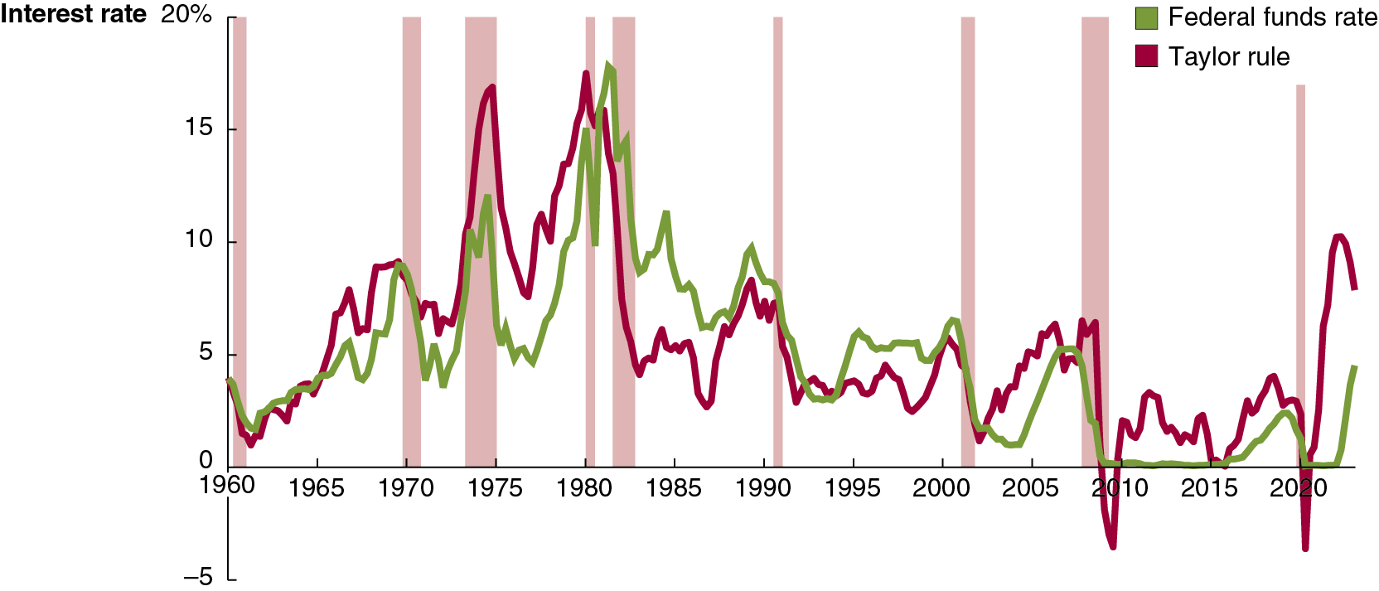
Figure 15.12 The Taylor Rule and Fed Behavior, 1960–2023 (1 of 2)
The Taylor rule does a good job of predicting the federal funds rate during most of this period, apart from the periods of high inflation in the 1970s and from early 2021 to early 2023, when the Taylor rule gives a higher target federal funds rate than the Fed used.
The Taylor rule also indicates a negative federal funds rate during 2009 and 2020, which isn’t possible because of the zero lower bound.
Notes:
The horizontal axis represents year, and ranges from 1960 to 2020, in increments of 5 years. The vertical axis represents interest rate, and ranges from negative 5 to 20%, in increments of 5%. The areas for recession periods, 1960 to 1961, 1968 to 1970, 1973 to 1975, 1980 to 1981, 1982 to 1983, 1990 to 1991, 2001 to 2002, 2007 to 2009, and 2020 are shaded. The line for Federal funds rate starts at 4 in 1960, rises to 8 in 1970, falls and rises, before and after recession periods, and peaks to 17 in 1980. The line then falls to 1 in 2006, reaches 0 between 2010 and 2016, rises to 3 in 2019, falls to 0 in 2020, and ends at 5 in 2023. The line for Taylor rule starts at 4 in 1960, rises to 8 in 1970, falls and rises, before and after recession periods, and rises to 16 in 1975, falls to 8 in 1977, then peaks to 17 in 1980. The line then falls to 1 in 2001, rises to 5 in 2009, falls to negative 3 in 2010, remains between 0 to 3, from 2010 to 2020, falls to negative 3 in 2020, rises to 10 in 2022, and ends at 5 in 2023. All values are estimated.

Slide 48
Figure 15.12 The Taylor Rule and Fed Behavior, 1960–2023 (2 of 2)
Following the Taylor rule would have resulted in a faster response to the Covid inflation than what the Fed actually enacted.
Taylor has proposed that the Fed adopt an explicit rule, like the Taylor rule, to guide its monetary policy actions. While the Fed need not exactly follow such a rule, it would be obliged to justify deviations.
The Fed resists such an approach, as it would limit its flexibility.
Notes:
The horizontal axis represents year, and ranges from 1960 to 2020, in increments of 5 years. The vertical axis represents interest rate, and ranges from negative 5 to 20%, in increments of 5%. The areas for recession periods, 1960 to 1961, 1968 to 1970, 1973 to 1975, 1980 to 1981, 1982 to 1983, 1990 to 1991, 2001 to 2002, 2007 to 2009, and 2020 are shaded. The line for Federal funds rate starts at 4 in 1960, rises to 8 in 1970, falls and rises, before and after recession periods, and peaks to 17 in 1980. The line then falls to 1 in 2006, reaches 0 between 2010 and 2016, rises to 3 in 2019, falls to 0 in 2020, and ends at 5 in 2023. The line for Taylor rule starts at 4 in 1960, rises to 8 in 1970, falls and rises, before and after recession periods, and rises to 16 in 1975, falls to 8 in 1977, then peaks to 17 in 1980. The line then falls to 1 in 2001, rises to 5 in 2009, falls to negative 3 in 2010, remains between 0 to 3, from 2010 to 2020, falls to negative 3 in 2020, rises to 10 in 2022, and ends at 5 in 2023. All values are estimated.

Slide 49
Inflation Targeting and the Fed’s New Monetary Policy Strategy
Inflation targeting: A framework for conducting monetary policy that involves the central bank announcing its target level of inflation.
In 2012, the Fed announced its first explicit inflation target: an average inflation rate of 2 percent per year.
The Fed can deviate from this target during severe recessions.
Some economists and policymakers oppose an explicit inflation target, believing it reduces the Fed’s flexibility.

Slide 50
Arguments For and Against Inflation Targeting
For:
Makes it clear that the Fed cannot affect real G D P in the long run.
Easier for firms and households to form expectations about future inflation, improving their planning.
Promotes Fed account-ability—provides a yardstick against which performance can be measured.
Against:
Reduces the Fed’s flexibility to address, and accountability for, other policy goals.
Assumes the Fed can correctly forecast inflation rates, which may not be true.
Increased focus on inflation rate may result in Fed being less likely to address other beneficial goals.

Slide 51
Average-Inflation Targeting
In August 2020, Fed Chair Powell announced a policy change:
“We will seek to achieve inflation that averages 2 percent over time. Therefore, following periods when inflation has been running below 2 percent, appropriate monetary policy will likely aim to achieve inflation moderately above 2 percent for some time… . Our approach could be viewed as a flexible form of average inflation targeting.”
This policy would affect inflation expectations: when inflation is higher than 2 percent, people would anticipate tighter monetary policy, and vice versa.

Slide 52
Should the Fed Target Nominal G D P?
Other economists and policymakers have suggested that the Fed should adopt nominal G D P targeting.
Example: If the Fed expected 3 percent annual real G D P growth and wanted 2 percent inflation, it would target 5 percent nominal real G D P growth.
If real G D P growth slowed, the policy would be expansionary.
If real G D P growth was faster than expected, the policy would be contractionary.
This policy is similar to a monetary growth rule, as desired by monetarists.
As of 2023, many central banks have adopted inflation targeting, while none had yet adopted nominal G D P targeting.

Slide 53
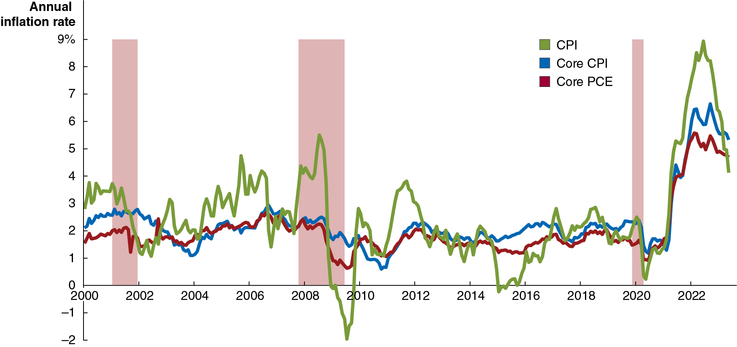
Apply the Concept: Should the Fed Worry about the Prices of Food and Gasoline? (1 of 2)
Which inflation rate does the Fed actually pay attention to?
Not the C P I: it is too volatile and probably overstates inflation.
It used to use the P C E (personal consumption expenditures) index, a broad price index similar to the G D P deflator.
Notes:
The horizontal axis represents year, and ranges from 2000 to 2022, in increments of 2 years. The vertical axis represents annual inflation rate, and ranges from negative 2 to 9%, in increments of 1%. The areas for recession periods, 2001 to 2002, 2007 to 2009, and 2020 are shaded. The C P I line, in green, has the most dramatic shifts, beginning at 3 in 2000, dropping to 1 by 2002, and rising and falling irregularly, mostly gaining until peaking at 6 in 2008, then falling to the lowest point of negative 2 by 2009. The line ultimately rebounds, and with some more gains and losses, maintains overall consistency between 2 and 0 until 2020, then peaks to 9% in 2022, and falls to 4% in 2023. The Core C P I line, in blue, has a tight pattern that ebbs and flows, beginning at 2, falling to 1 in 2004, and having subtle rises and falls, with the highest point of 2.7 in 2007, and lowest at 0.9 in 2011. The line rises to 6.5% in 2022, and ends at 5.5% in 2023. The Core P C E line, in red, follows a similar path as core C P I, differing mostly between 2000 and 2004, when the rate was between 1.7 and 1.2. The line reaches 5% in 2022, and ends at 4.5% in 2023. All values are estimated.

Slide 54
Apply the Concept: Should the Fed Worry about the Prices of Food and Gasoline? (2 of 2)
Which inflation rate does the Fed actually pay attention to?
Since 2004, it has used the “core P C E”: the P C E without food and energy prices. The core P C E is more stable; the Fed believes it estimates true long-run inflation better.
Notes:
The horizontal axis represents year, and ranges from 2000 to 2022, in increments of 2 years. The vertical axis represents annual inflation rate, and ranges from negative 2 to 9%, in increments of 1%. The areas for recession periods, 2001 to 2002, 2007 to 2009, and 2020 are shaded. The C P I line, in green, has the most dramatic shifts, beginning at 3 in 2000, dropping to 1 by 2002, and rising and falling irregularly, mostly gaining until peaking at 6 in 2008, then falling to the lowest point of negative 2 by 2009. The line ultimately rebounds, and with some more gains and losses, maintains overall consistency between 2 and 0 until 2020, then peaks to 9% in 2022, and falls to 4% in 2023. The Core C P I line, in blue, has a tight pattern that ebbs and flows, beginning at 2, falling to 1 in 2004, and having subtle rises and falls, with the highest point of 2.7 in 2007, and lowest at 0.9 in 2011. The line rises to 6.5% in 2022, and ends at 5.5% in 2023. The Core P C E line, in red, follows a similar path as core C P I, differing mostly between 2000 and 2004, when the rate was between 1.7 and 1.2. The line reaches 5% in 2022, and ends at 4.5% in 2023. All values are estimated.

Slide 55
15.6 Fed Policies During the 2007–2009 and 2020 Recessions
Describe the policies the Federal Reserve used during the 2007–2009 and 2020 recessions.
A bubble in a market refers to a situation in which prices are too high relative to the underlying value of the asset.
Bubbles can form due to:
Herding behavior: Failing to correctly evaluate the value of the asset and instead relying on other people’s apparent evaluations; and/or
Speculation: Believing that prices will rise even higher and buying the asset intending to sell it before prices fall.
Example: Stock prices of internet-related companies were “optimistically” high in the late 19 90s, before the “dot-com bubble” burst, starting in March 2000.

Slide 56
The Inflation and Deflation of the Housing Market Bubble
By 2005, many economists argued that a bubble had formed in the U.S. housing market.
The high prices resulted in high levels of investment in new home construction, along with optimistic sub-prime loans.
During 2006 and 2007, house prices started to fall, in part because of mortgage defaults, and new home construction fell considerably.
Banks became less willing to lend, and the resulting credit crunch further depressed the housing market.

Slide 57
The Changing Mortgage Market
Until the 19 70s, when a commercial bank granted a mortgage, it would “keep” the loan until it was paid off.
This limited the number of mortgages banks were willing to provide.
A secondary market in mortgages was made possible by the formation of the Federal National Mortgage Association (“Fannie Mae”) and the Federal Home Loan Mortgage Corporation (“Freddie Mac”).
These government-sponsored enterprises (G S E s) sell bonds to investors and use the funds to purchase mortgages from banks.
This allowed more funds to flow into mortgage markets.

Slide 58
The Role of Investment Banks
By the 2000s, investment banks had started buying mortgages also, packaging them as mortgage-backed securities and reselling them to investors.
These securities were appealing to investors because they paid high interest rates with apparently low default risk.
But with more money flowing into mortgage markets, “worse” loans started to be made to people:
With worse credit histories (sub-prime loans)
Without evidence of income (“Alt-A” loans)
With lower down-payments
Who couldn’t initially afford traditional mortgages (adjustable-rate mortgages start with low interest rates)

Slide 59
Apply the Concept: The Wonderful World of Leverage
Why does the size of the down payment matter?
By owning a house, you become exposed to increases or decreases in the price of that large asset.
With a smaller down payment, you are said to be highly leveraged, exposed to large potential changes in the value of your investment.
Down Payment | Return on your investment as a result of … a 10% increase in the price of your house | Return on your investment as a result of … a 10% decrease in the price of your house
100% | 10% | negative 10%
20 | 50 | negative 50
10 | 100 | negative 100
5 | 200 | negative 200

Slide 60
Result of the Lower Quality Loans
When the housing bubble burst, more of these lower-quality loans were defaulted on than investors were expecting.
The market for securities based on these loans became very illiquid—few people or firms were willing to buy them, and their prices fell quickly.
Many commercial and investment banks were invested heavily in these mortgage-backed securities, and so suffered heavy losses.
These problems were so profound that the Fed and the U.S. Treasury decided to take unprecedented actions.

Slide 61
Table 15.2 Treasury and Fed Actions at the Beginning of the Financial Crisis of 2007–2009 (1 of 2)
Date | Action | Goal
March 2008 | Although the Fed had traditionally made discount loans only to commercial banks, the Fed announced it would temporarily make discount loans to primary dealers—firms that participate in regular open market transactions with the Fed. | Provide short-term funds to these dealers, some of which are investment banks, so they would not have to raise funds by selling securities, which might further reduce the prices of these securities.
March 2008 | The Fed announced that it would loan up to $200 billion of Treasury securities in exchange for mortgage-backed securities. | Make it possible for primary dealers that owned mortgage-backed securities that were difficult or impossible to sell to have access to Treasury securities that they could use as collateral for short-term loans.

Slide 62
Table 15.2 Treasury and Fed Actions at the Beginning of the Financial Crisis of 2007–2009 (2 of 2)
Date | Action | Goal
March 2008 | The Fed and the Treasury helped J P Morgan Chase acquire the investment bank Bear Stearns, which was close to failing. | Avoid a financial panic that the Fed and the Treasury believed would result from the failure of Bear Stearns. Its failure might have caused many investors and financial firms to stop making loans to other investment banks.
September 2008 | The Treasury moved to have the federal government take control of Fannie Mae and Freddie Mac. Although the federal government sponsored Fannie Mae and Freddie Mac, they were actually private businesses. The firms were placed under the supervision of the Federal Housing Finance Agency. | Avoid further devastating a weak housing market. The Treasury believed that the bankruptcy of Fannie Mae and Freddie Mac would have caused a collapse in confidence in mortgage-backed securities.

Slide 63
Responses to the Failure of Lehman Brothers
Many economists were critical of the Fed underwriting Bear Stearns, as managers would now have less incentive to avoid risk: a moral hazard problem.
So in September 2008, the Fed did not step in to save Lehman Brothers, another investment bank experiencing heavy losses. This was supposed to signal to firms not to expect the Fed to save them from their own mistakes.
Lehman Brothers declared bankruptcy on September 15, 2008.
Financial markets reacted adversely—more strongly than expected.
When American International Group (A I G) began to fail a few days later, the Fed reversed course, providing them with a $85 billion loan.

Slide 64
The Fed Responds to the Covid-19 Recession
The Fed cut its target for the federal funds rate to zero and introduced temporary lending facilities that would allow it to make loans to businesses other than commercial banks.
The Fed used two types of lending facilities:
Liquidity facilities: expanding its role as lender of last resort to firms in the shadow banking system, and aggressively lending in the repurchase market
Credit facilities: allowing the Fed to provide funds directly to nonfinancial firms, and to state and local governments
These actions helped to avoid a credit crunch like during the 2007–2009 recession; but they probably prevented the Fed from acting quickly to combat inflation.

Slide 65
Online Appendix: The Money Market and the Fed
Describe how the Federal Reserve can use control of the money supply to affect short-term interest rates.
A model of the money market provides some insight into factors that can affect short-term interest rates.
This model was more important when there seemed to be stronger links between the money supply and economic variables of interest, like output, unemployment, and the price level.
The Fed stopped setting targets for the money supply in 1993.

Slide 66
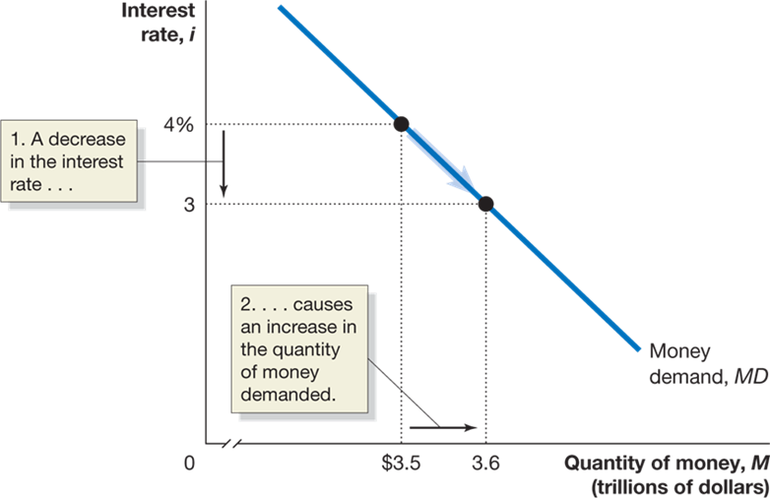
Figure 15A.1 The Demand for Money
Higher interest rates result in a lower quantity of money demanded.
Why? When the interest rate is high, interest-earning alternatives to holding money begin to look attractive—like U.S. Treasury bills.
The opportunity cost of holding money is higher when the interest rate is high.
Notes:
The truncated X axis represents quantity of money, M, in trillions of dollars, and the Y axis represents interest rate, I. The money demand line, MD falls through the points (3.5, 4), and (3.6, 3). The decrease in interest between 4 and 3 percent causes an increase in the quantity of money needed.

Slide 67
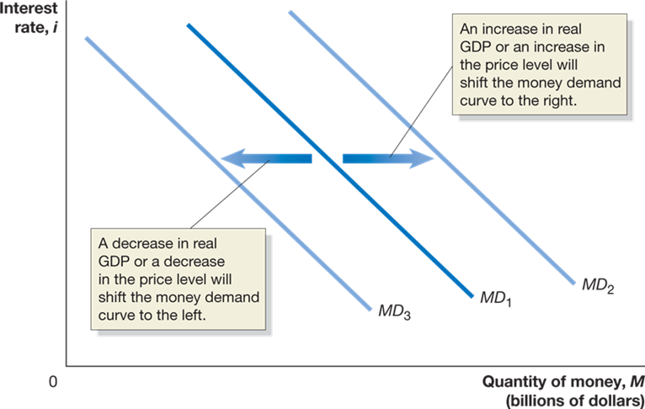
Figure 15A.2 Shifts in the Money Demand Curve
What could cause the money demand curve to shift?
A change in the need to hold money, to engage in transactions.
For example, if more transactions are taking place (higher real G D P) or more money is needed for each transaction (higher price level), the demand for money will be higher.
Decreases in real G D P or the price level decrease money demand.
Notes:
The X axis represents quantity of money, M, in trillions of dollars, and the Y axis represents interest rate, I. The money demand line, MD sub 1 shifts right and becomes MD sub 2. An increase in real GDP or an increase in the price level will shift the money demand curve to the right. When MD sub 1 shifts left, and becomes MD sub 3, a decrease in real GDP or a decrease in the price level will shift the money demand curve to the left.

Slide 68
How Does the Fed Manage the Money Supply?
We saw in Chapter 24 that the Fed could alter the money supply by buying and selling U.S. Treasury securities—open market operations.
To increase the money supply, the Fed buys those securities; the sellers deposit the sale proceeds in a checking account; and the money gets loaned out—increasing the money supply.
Contracting the money supply would require selling securities.

Slide 69
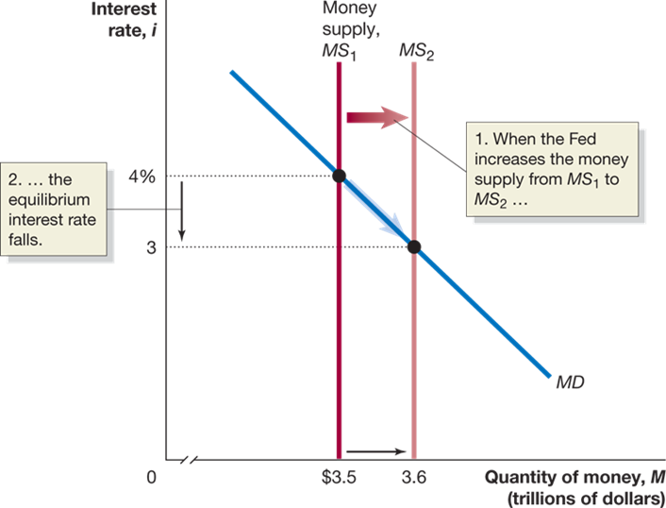
Figure 15A.3 The Effect on the Interest Rate When the Fed Increases the Money Supply
For simplicity, we assume the Fed can completely control the money supply.
Then the money supply curve is a vertical line— it does not depend on the interest rate.
Equilibrium occurs in the money market where the two curves cross.
When the Fed increases the money supply, the short-term interest rate must fall until it reaches a level at which households and firms are willing to hold the additional money.
Notes:
The truncated X axis represents quantity of money, M, in trillions of dollars, and the Y axis represents interest rate, I. Money supply line MS sub 1 shifts right and becomes MS sub 2. When the Fed increases the money supply from MS sub 1 to MS sub 2, the equilibrium interest rate falls. The money demand line, MD intersects MS sub 1 at (3.5, 4), and MS sub 2 at (3.6, 3).

Slide 70
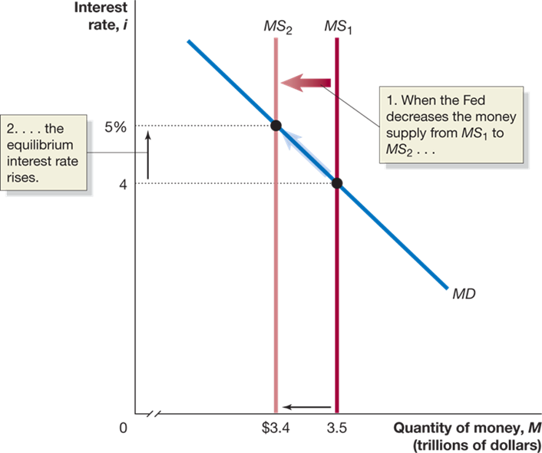
Figure 15A.4 The Effect on the Interest Rate When the Fed Decreases the Money Supply
Alternatively, the Fed may decide to lower the money supply by selling Treasury securities.
Now firms and households (who bought the securities with money) hold less money than they want, relative to other financial assets.
To retain depositors, banks are forced to offer a higher interest rate on interest-bearing accounts.
Notes:
The truncated X axis represents quantity of money, M, in trillions of dollars, and the Y axis represents interest rate, I. Money supply line MS sub 1 shifts left and becomes MS sub 2. When the Fed decreases the money supply from M S sub 1 to M S sub 2, the equilibrium interest rate rises. The money demand line, MD intersects MS sub 1 at (3.5, 4), and MS sub 2 at (3.4, 5).

Slide 71
A Tale of Two Interest Rates
We now have two models of the interest rate:
The loanable funds model (Chapter 20)
Concerned with long-term real rate of interest
Relevant for long-term investors (firms making capital investments, households building new homes, etc.)
The money market model (this chapter)
Concerned with short-term nominal rate of interest
Most relevant for the Fed: changes in money supply directly affect this interest rate
Usually, the two interest rates are closely related; an increase in one results in the other increasing also.

Slide 72
Choosing a Monetary Policy Target
The Fed can choose to target a particular level of the money supply or a particular short-term nominal interest rate.
Apart from a period in the late 1970s and early 1980s, the Fed has focused on interest rates rather than the money supply.
One reason: the relationship between the money supply (M1 or M2) and real G D P growth broke down in the early 1980s (M1) and 1990s (M2).

Slide 73
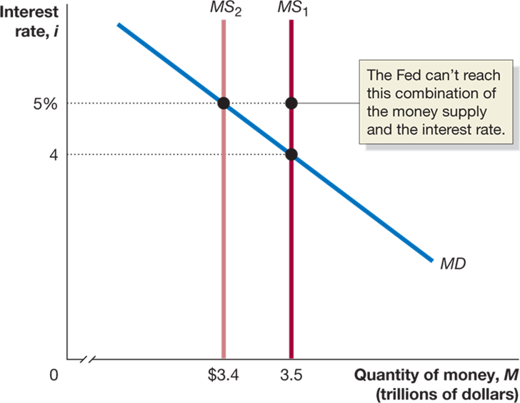
Figure 15A.5 The Fed Can’t Target Both the Money Supply and the Interest Rate
It might seem that the Fed could “get the best of both worlds” by targeting both interest rates and the money supply.
But this is impossible: the two are linked through the money demand curve, which the Fed does not control.
So a decrease in the money supply will increase interest rates; an increase in the money supply will decrease interest rates.
Notes:
The truncated X axis represents quantity of money, M, in trillions of dollars, and the Y axis represents interest rate, I. The money demand line, MD intersects MS sub 1 at (3.5, 4), and MS sub 2 at (3.4, 4). MS sub 1 also intersects point (3.5, 5). The Fed can’t reach this combination of the money supply and the interest rate.

Slide 74

Copyright
This work is protected by United States copyright laws and is provided solely for the use of instructors in teaching their courses and assessing student learning. Dissemination or sale of any part of this work (including on the World Wide Web) will destroy the integrity of the work and is not permitted. The work and materials from it should never be made available to students except by instructors using the accompanying text in their classes. All recipients of this work are expected to abide by these restrictions and to honor the intended pedagogical purposes and the needs of other instructors who rely on these materials.

